Slide 1

LoRaWAN for Agricultural Sensors
Team 1 | Team 2 | Team 3
Bailey Ballard | Kelby Fredrick | Jack McFarlane
Ryan James | John Manherz

Slide 2
Introduction
What we are developing:
LoRaWAN radios with environmental sensors in waterproof boxes.
We are adding LoRaWAN transmission to stationary platforms.
A LoRaWAN that transmits to a ground based system and show sensor and GPS readings with time stamps to better locate the drone.
What problem are we solving:
Measuring temperature, pressure, solar radiation, wetness, and other factors.
Automatic reporting of the devices periodically.
1 year battery life.
Transmission of data and File data compression

Slide 3


Introduction part 2
Areas of ues:
Agricultural fields
Products already in the market:
GroPoint,
RainBird smrt-y Soil Moisture Sensor
Notes:
Build up LoRaWAN radios with environmental sensors on boards in
waterproof boxes for specific applications in the agricultural field.
The applications typically include temperature, pressure, solar
radiation, and some measurement of wetness as well as other sensors. The
devices can report infrequently, every to 15 minutes since the
environment does not change quickly. The devices should work six months
to a year on a battery.
2) Work with the sentinel team to add LoRaWAN transmission to the
stationary sentinel platform. This means interfacing a LoRaWAN radio to
communicate with a Raspberry Pi or Jetson Nano and move image data from
the Pi or Nano to a central server. The LoRaWAN is slow and will move at
most 100kbs. Than means a 5MByte file will take 7 min minimum. With
signaling overhead it could go up to 20 min. So, file data compression
is essential. Also, only two or three pictures are needed a day.
3) LoRAWAN for mobile platforms, develop a LoRaWAN that transmits to a
ground based system and show sensor and GPS readings with time stamps to
better locate the drone. Provide real time data while the drone goes
over the field. Characterized the transmission in the field environment
and look at the maximum transmission distance. Send information from
drone AI systems on indicating where ground observation or intervention
would be useful.

Slide 4
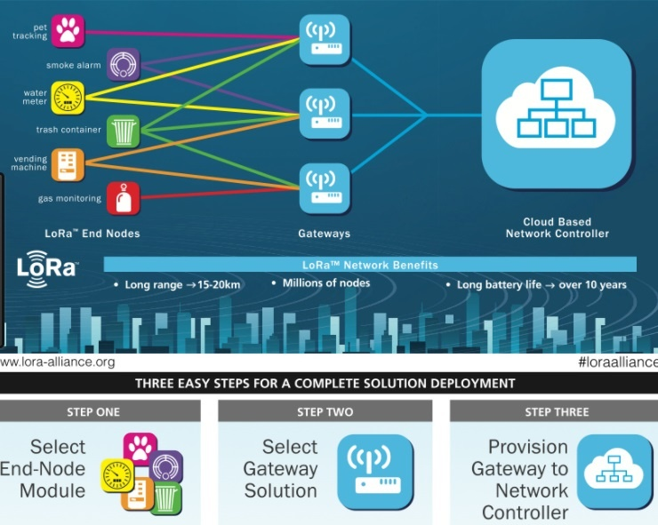
Team 1: Description
Build LoRaWAN radios with environmental sensors in waterproof boxes
Sensors include:
Temperature
Pressure
Solar radiation
Some measurement of wetness (humidity)
Send data every 15 minutes
Last six months to a year on a battery

Slide 5
Team 1: Hardware Block Diagram
Environmental Sensors
GPIO
LoRaWAN Radio Module + ESP32 (Gateway)
Central Station (Network Server)
Solar Panels
Power
(Battery)

Slide 6
Team 1: Software Flow Chart
Start
Send data to central command point
Process data
Sleep: Low-power mode
Send data to LoRaWAN via comm. protocol
NO
Has 15 minutes passed?
Wake up: Read Analog Sensor data
YES

Slide 7
Team 2: Description
Work with the Sentinel team to add LoRaWAN transmission to the stationary sentinel platform
Interface LoRaWAN radio to communicate with Raspberry Pi/Nano to move image data to a central server
LoRaWAN is slow and will move at 100kbs (signaling overhead could take ≤ 20 minutes)
File compression is essential
2 or 3 pictures will be needed a day

Slide 8
Team 2: Hardware Block Diagram
Image Data
Jetson Nano
SPI
LoRaWAN Radio Module
Sentinel Platform
Solar Panels
Power
(Battery)

Slide 9
Team 2: Software Flow Chart
Start
Send data to central command point
Process data
Have 8 hours (32 15-minute periods) elapsed?
→ It is worth noting that the raspberry Pi does include a dedicated input port allowing for high-res photos to take photos and video. These can be analyzed in real time, or saved for later processing using specific python libraries.
→ Done via secure IP
Send data to LoRaWAN via comm. protocol
NO
Ignore
Capture Image and save in real time

Slide 10
Team 3: Description
Develop a LoRaWAN module that transmits to a ground based system to transmit sensor and GPS readings.
Provide real time data from mobile drone system about observations, time and location
Characterize field transmission to optimize transmission distance
Transmit to ground system with all necessary sensor information

Slide 11
Team 3: Hardware Block Diagram
GPS
Onboard computer
LoRAWAN receiver
Sensors
LoRAWAN module
Time
Drone
Base station

Slide 12
Team 3: Software Flow Chart
Start
Raise Intervention flag and send observation and meta data to GND
Take ground observation via drone
Package data for optimal transmission
NO
YES
Catalog time, gps and sensor data of indicated area
Is intervention needed

Slide 13
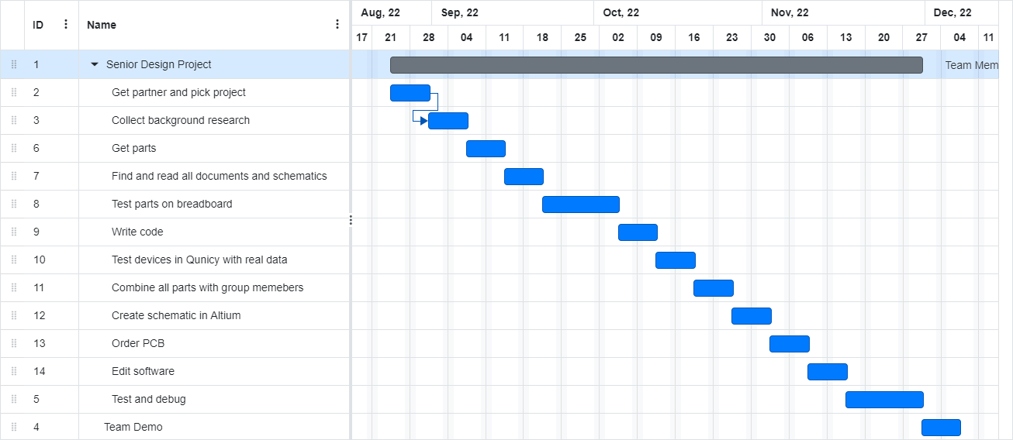
Gantt Chart

Slide 14
Questions?

